Slide 1
UAV Collision Detection & Prevention
Midterm Check-In
Group Members: Felicia Huffman, Sam Weiss, Jacob Brendemuehl, and Olivia Gette

Slide 2


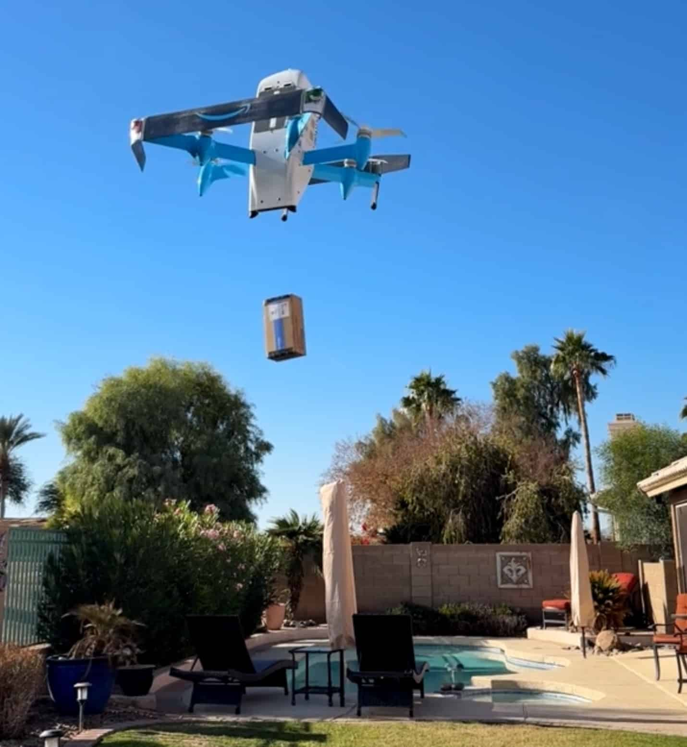
Project Overview

Slide 3
Motivation
Our team is focused on creating UAV collision detection and avoidance solutions in a delivery context with the use of minimal sensors.
Motivation: UAVs are a hot topic
One of their major selling points is affordability
However, current self flying AI requires expensive sensor arrays
Our goal is to see what level a drone can achieve using LiDAR alone
Possible stakeholders include Waymo, Amazon, and the DOD
Notes:
Sam

Slide 4
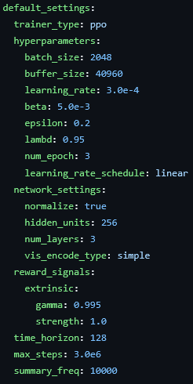

Reinforcement/Imitation Learning Approach
Focused on developing a minimal MLP to iterate on
Unity env has intuitive physics and collision frameworks
ML Agents is the best reinforcement learning library available
Figure 1: hyperparameters
Notes:
Sam

Slide 5
Unity and LiDAR Sensor Setup
Unity is a cross-platform real-time 3D development platform
We are using Unity to simulate the environment for drone collision
Unity allows us to create/manage assets, scripts, and environments to manipulate our drone and the items around it
Our Unity Environment currently is a neighborhood mockup from a unity asset pack on the Unity store
LiDAR is a remote sensing method that uses pulses of laser light to measure distances and precise 3D models of objects and environments.
Our drone is utilizing LiDAR to detect and report objects and surfaces that are close to or in the path of the drone
Notes:
Jacob

Slide 6
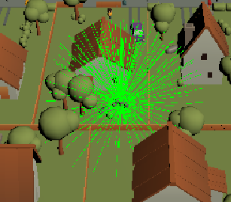
Unity and LiDAR Sensor Setup cont.
Our drone has a sensor on the top and bottom that emit 2 hemispheres of lasers
Both hemispheres emit 144 lasers roughly every 15 degrees, 288 lasers in total.
The lasers detect and record the x,y,z position of objects and surfaces relative to the drone (the drone is the origin at 0,0,0) into a csv file in real time as the drone moves around the environment
Within the Unity environment, there is a visual to see the lasers and how they emit from each sensor (displayed on the right)
Figure 2: Lidar lasers shown in Unity
Notes:
Jacob

Slide 7
Progress to Date

Slide 8
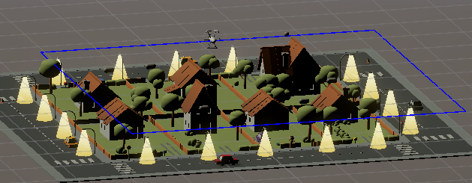
Current Scene
Our current scene includes the following obstacles to avoid:
Trees
Houses
Moving cars
Birds
Light posts
People
Fences
Additionally, we have:
Drone agent
Goal
Figure 3: Current Unity Scene
Notes:
Felicia

Slide 9
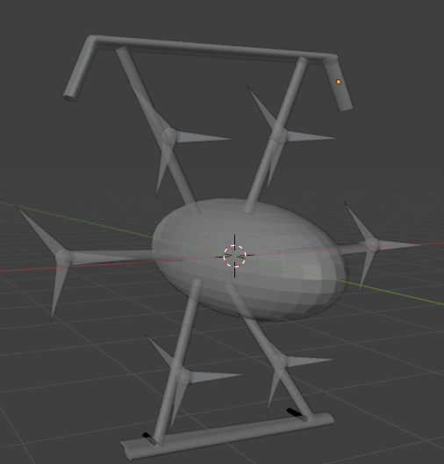
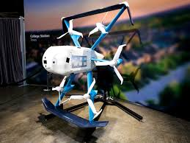
Drone Agent
Simulating an MK30 Amazon delivery drone
6 propellers, 2 airfoils for more efficient horizontal movement
Known:
Mass: 2.3 kg
Weight: 5 lbs
Estimated:
Linear Damping: 0.15
Angular Damping: 0.10
Figure 5: MK30 Amazon Drone
Figure 4: Modeled drone in Blender
Notes:
Felicia

Slide 10
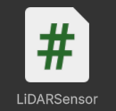
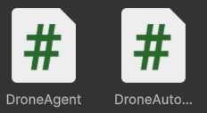
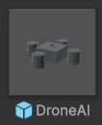
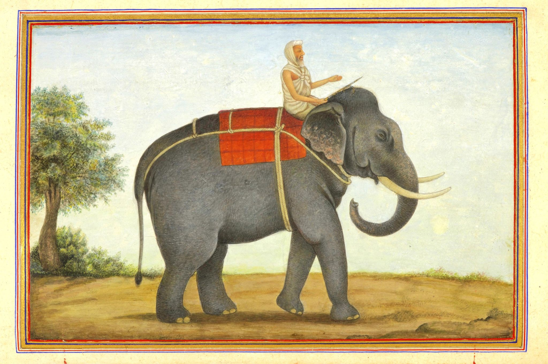
Classes, Logic, and Reward Structure I
Presently, our AI autopilot is organized into
N LiDAR data points
And some other state information
A single agent
Process inputs, chooses actions
A single stabilizer script
Fights to keep the drone upright
Also listens to the agent, exposing 3 controls
M Rotors
Listens only to the stabilizer script
Figure 6: Files
Notes:
Sam

Slide 11
Classes, Logic, and Reward Structure II
// REWARDS
// Distance reward, higher if moving towards the goal but becomes negative if moving away
float dist = Vector3.Distance(transform.position, goal.position);
if (dist + 0.1f < bestDist) { bestDist = dist; noImproveTimer = 0f; }
else noImproveTimer += Time.fixedDeltaTime;
if (noImproveTimer > 5f) { AddReward(-1f); EndEpisode(); return; } // Early stopping condition for no improvement, TODO: overly penalizing?
// Always:
AddReward(0.2f * (prevDist - dist)); // + if closer, - if farther
prevDist = dist;
// Alignment reward, reward for facing toward the goal, can be negative if facing away
Vector3 dir = (goal.position - transform.position).normalized;
float align = Vector3.Dot(transform.forward, dir); // -1..1
AddReward(0.02f * align);
// Success condition
if (dist < successRadius && rb.linearVelocity.magnitude < 0.5f && tilt < 10f)
{
AddReward(+50.0f);
EndEpisode();
}
// END
// FAILURES
// Collision penalty handling
if (collisionQueued && (Time.time - lastCollisionPenaltyTime) >= collisionCooldown)
{
// Collision are always bad, punish
float penalty = collisionPenalty + (impactScale * queuedCollisionSpeed);
AddReward(penalty);
// If bad enough, a collision can end the episode
if (endEpisodeOnCrash && (queuedCollisionSpeed >= hardCrashSpeed))
{
AddReward(-1.0f); // fatal crash has extra penalty
EndEpisode();
return;
}
// Consume event and start cooldown
collisionQueued = false;
queuedCollisionSpeed = 0f;
lastCollisionPenaltyTime = Time.time;
}
// Excessive tilt or timeout
if (tilt > maxTiltDeg || timer > maxEpisodeTime)
{
AddReward(-1.0f);
EndEpisode(); // failure reached, should end episode
}

Slide 12
Preliminary Analysis
Main Goal: Understand the initial behaviour and performance of drones and LiDAR and how to implement these features in Unity.
Focus Areas:
Physics Accuracy: Mass, Gravity, Thrust, and Motor Strength
Sensor Performance: LiDAR scans, accurate readings from each hemisphere
Data Logging: CSV output successfully records position, velocity and acceleration per scan
Environment Setup: All objects and surfaces have accurate colliders and interact with the drone correctly
Notes:
Jacob

Slide 13
Data Captured
The LiDAR utilizes 2 scripts, LiDAR_Sensor and LiDAR_Logger
LiDAR Logger logs the data captured from the LiDAR into a csv file in real time.
With each run/session it creates a new CSV file and stores it into a folder within our Unity Project
Each CSV file contains:
Time in increments of 0.5 seconds
Yaw, Pitch, and Roll (degrees)
Acceleration and velocity (for x,y,z directions)
Motor strength for each motor (not yet implemented)
Notes:
Jacob

Slide 14
Data Captured Pt. 2
For each beam it records:
The x,y, and z position of a scanned object/surface
The euclidean distance (the "straight-line" distance between two points in a Euclidean space, calculated using a generalized form of the Pythagorean theorem)
The azimuth angle (the horizontal direction measured in degrees clockwise from true north)
The elevation angle (the angle between the horizontal line of sight and a line of sight to an object above the observer)
Whether it hits an object or not determined by a 0 or 1

Slide 15
Next Steps

Slide 16
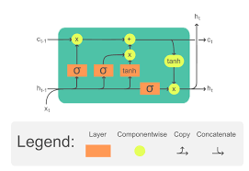
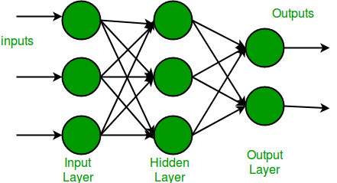
Planned Improvements
The environment realism
The training loop quality
The actuators
Multiple policies/agents
Move to a time-series architecture
Increase complexity & compute
Notes:
Sam

Slide 17
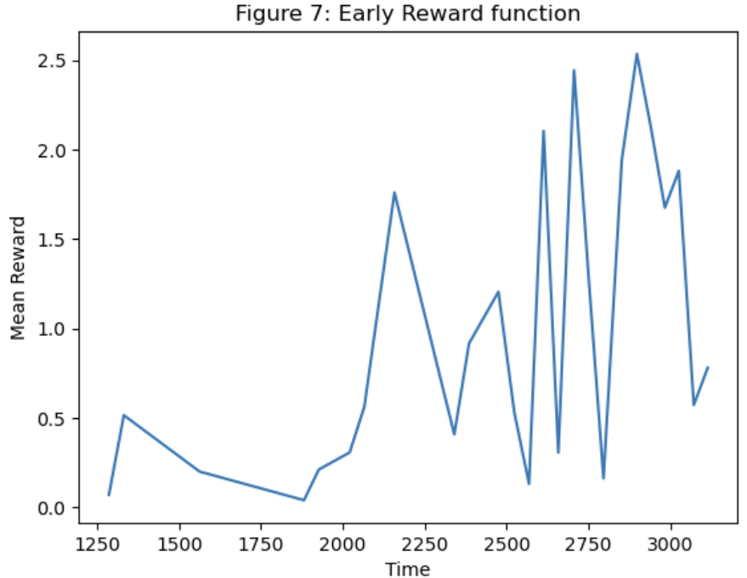
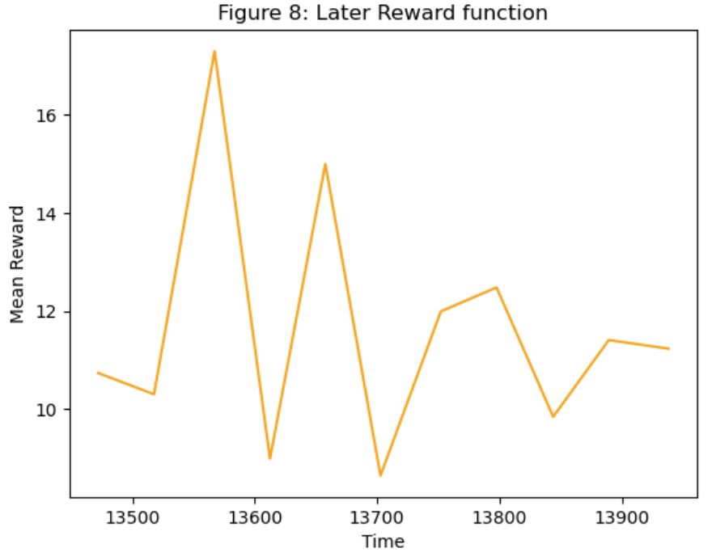
Evaluation Metrics
We are using mean reward over 10k steps
Reach goal → positive reward (+50)
Collide with objects → negative reward
Step cost → negative reward
We are currently averaging around 11 for the mean reward
Notes:
Felicia

Slide 18
Challenges and Risks
Time limit and commitment
There is only so much time in a single semester to get work done along with all 4 team members having other responsibilities to battle with
Software and training
We all had to learn or familiarize ourselves with new software and techniques to complete several aspects of this project
Training a model from scratch is also difficult so we have been focusing on implementing imitation learning from outside data and reinforcement learning to teach the drone
Notes:
Jacob

Slide 19
Challenges and Risks Pt. 2
Familiarizing ourselves with Unity and how to create and manipulate environments
Not using a real drone, we are simulating this project in Unity which doesn’t give us a fully accurate representation of the drone
Also working with extremely large datasets, understanding what columns mean, picking and choosing what’s useful and utilizing that to train our model
The biggest challenge is just connecting all the pieces together from the unity environment, the model training, and the datasets to get to a conclusive point in our project

Slide 20
Milestones/Outline for Future Progress
Milestone | Status
Brainstorming, Project Proposal, Find Dataset | Done! ✅
Set up Project, Data Exploration & Cleaning, Familiarize with Technologies/Tools, Starting the Simulation | Done! ✅
Training simulation, Reward Functions, Model Selection/Evaluation | In progress…
Model Optimization & Tuning, Prettify | Week 10 - 11
Widget, Dashboard, Finalize Code, Begin Report | Week 12
Demonstration, Evaluation, Report | Week 13 - 14
Notes:
Felicia

Slide 21
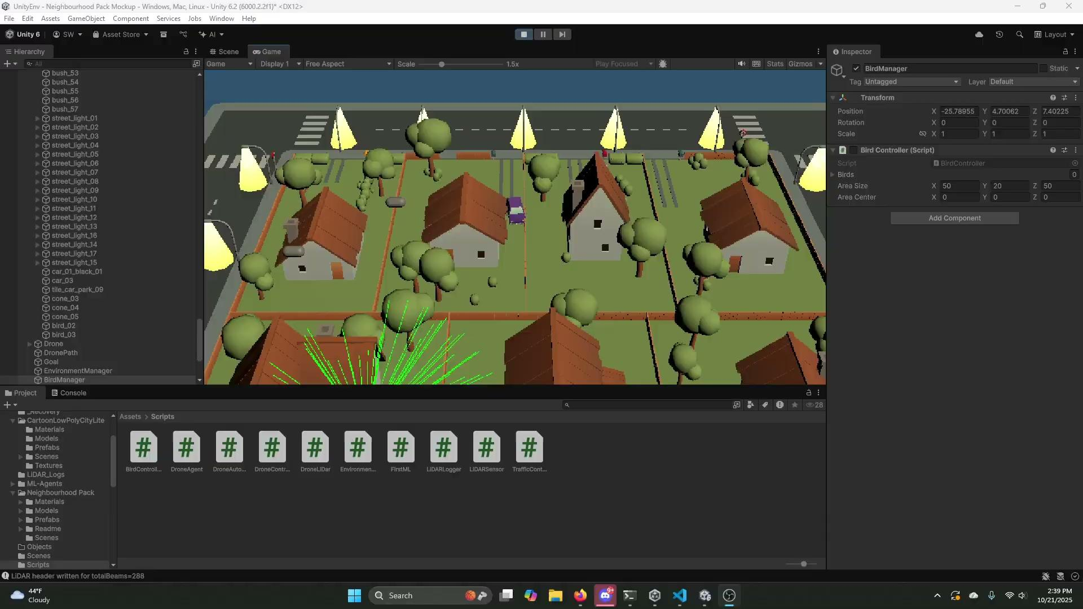
Demo:

Slide 22
Questions?

